Slide 1
Project Title: Flight Passengers Satisfaction Model (Classification Machine Learning Model)
By,
Pravin Varak

Slide 2
Introduction to Dataset
The dataset I chose for the project is taken from kaggel.com
Data set is a past history of flight passengers of that particular Aviation company.
This study aims to delve into the intricate factors that influence passengers' overall satisfaction with their flight experiences.
In an era where air travel has become an integral part of modern life, understanding and enhancing passenger satisfaction is paramount for airlines striving to excel in a highly competitive industry.

Slide 3
Problem Statement
Problem Statement: “Create a prediction model for an Aviation company with the help of past data, whether the passenger is SATISFIED or NEUTRAL/DISSATISFIED”
Prediction Task: It’s a classification Machine Learning Problem (Model)
Imp of Problem Solving: Solving this problem company can understand feedback of its passenger in better way. It will help them grow their business by taking correct professional decisions & improve the business process.

Slide 4
Data Overview
It’s a dynamic data with 24 features of about 1.5 lakh passengers.
The target of the study is whether the passenger is satisfied or not with services provided during his/her journey.
While studying the data I understood that every single feature (except noisy features like; passenger id, name) is highly influential with the target variable.
Though I had to do some data cleaning process, but overall data quality is very good.

Slide 5
Data Preprocessing
Got the data file on the python IDE
Made a copy of the original data
Dropped noisy columns like Passenger Id, Names
Checked for null values. ‘Arrival Delay in Minutes’ had 477 missing values & all other features had 1 missing value
Replaced missing values by mean in the ‘Arrival Delay in Minutes’ feature.
Probably the 1 missing value was identified in other features was of a single passenger. Dropped that 1 missing value with [.dropna()]

Slide 6
Outliers:
Checked for outliers through box plot for each feature.
Out of 23 features 18 were numerical & 5 were categorical features.
Plotted 18 different box plots for each numerical feature. Out of which 4 features had outliers values & all the other features had scaled values in it.
To name outliers features are as follows;
'Flight Distance’
'Checkin service’ : This feature had lower outliers
'Departure Delay in Minutes’
'Arrival Delay in Minutes'

Slide 7
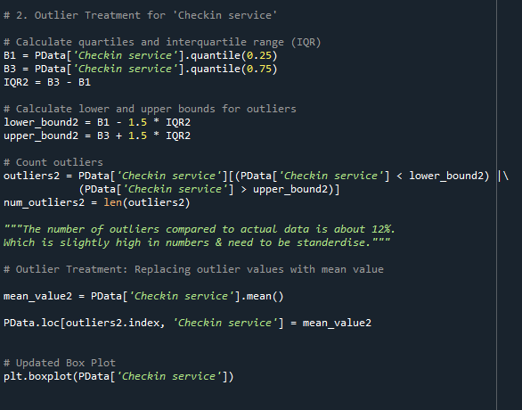
Outlier Treatment:
Steps I used in Outlier Treatment
Calculate quartiles and interquartile range (IQR)
Calculate lower and upper bounds for outliers
Count outliers
Outlier Treatment: Replacing outlier values with mean value

Slide 8
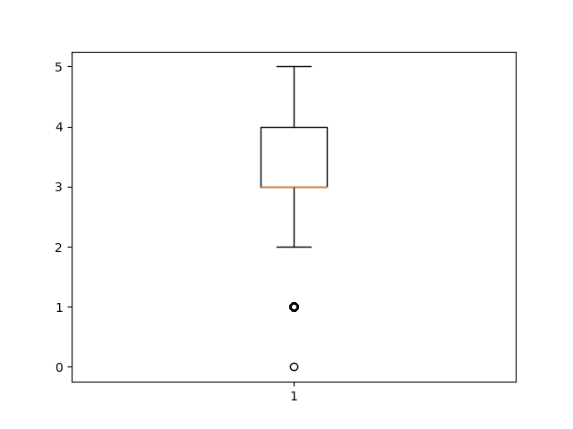
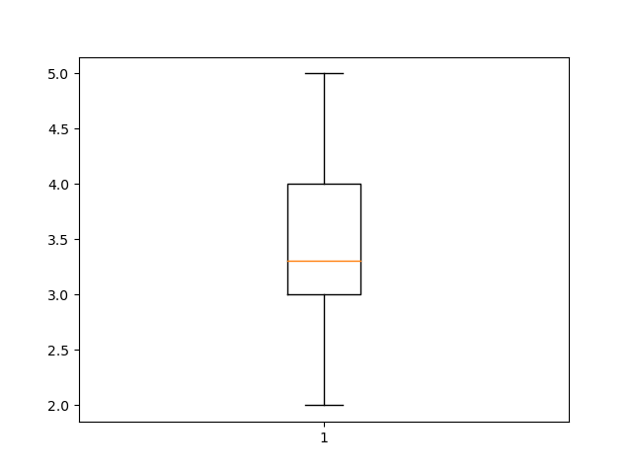
Box plot: 'Checkin service'
Updated Box Plot: 'Checkin service'

Slide 9
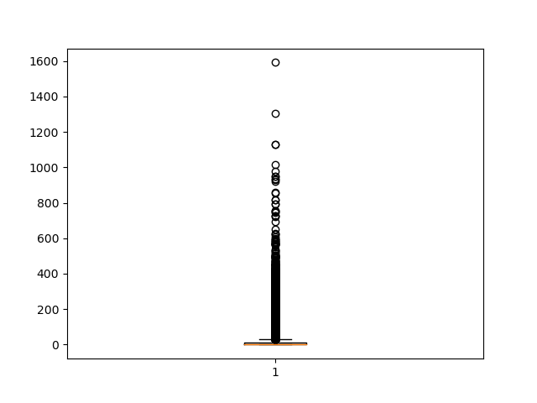
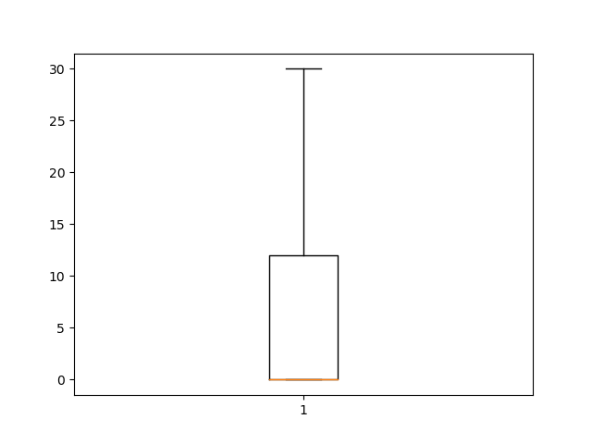
Box Plot: 'Departure Delay in Minutes'
Updated Box Plot: 'Departure Delay in Minutes'

Slide 10
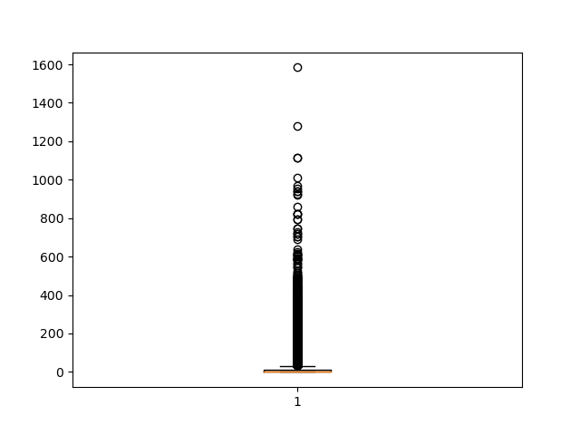
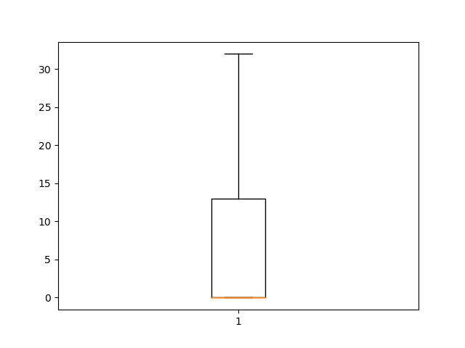
Box Plot: 'Arrival Delay in Minutes'
Updated Box Plot: 'Arrival Delay in Minutes'

Slide 11
Data Transformation: Categorical Encoding
After outlier treatment. We move to the next step.
One Hot Encoding to categorical / Object Data Type Columns. As the categorical data we have in this data set is not in hierarchical order, I used One Hot encoding to convert categorical data in to numerical order.

Slide 12
Data Transformation: Data Preparation
In next step we separate input features & target variable.
X is assigned to input features
Y is assigned to Target variable.
We prepare the data for training & testing purpose & separated it with help of [.iloc] method from pandas library.

Slide 13
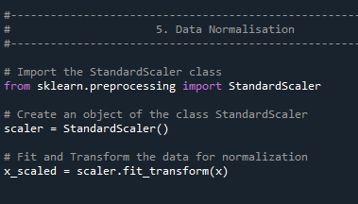
Data Transformation: Data Normalisation
In this process I scaled the data on a similar scale using [StandardScaler] class
I used it only for input features as we are solving classification prediction problem
The StandardScaler class contains methods and attributes for scaling and transforming data to have a mean of 0 and a standard deviation of 1, which is a common technique in feature scaling for various machine learning algorithms.

Slide 14
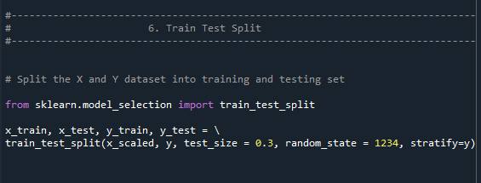
Data Transformation: Train Test Split
In the next step we split the data in to Training Data & Testing Data using [train_test_split] function.
With the test_size = 0.3 data gets separated in to 70% & 30% formation.
70% gets assigned to Training data, 30% to Testing Data.
stratify=y helps in preserving the proportion of each class in the target variable y in both the training and testing datasets.

Slide 15
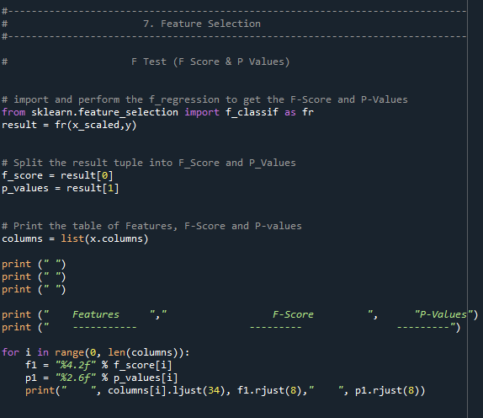
Feature Selection: F Test
In this step we perform F Test to find F score & P Value.
In feature selection P value of feature should be <0.05 to have strong influence on the target variable.
It is used for removing less influential features & avoid over fitting of model
Sharing the screen shot of the code.

Slide 16
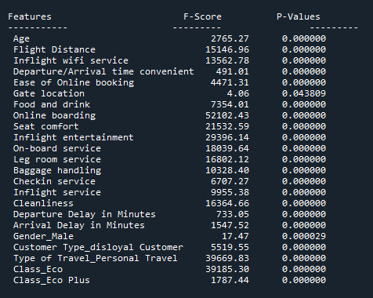
Feature Selection: F Test
Shared the out put of the F test.
In the out put we can clearly see that all the features are highly influential to target variable.
In next step we will find if there is any multi collinearity between features with respect to target variable.

Slide 17
Model Selection
Since we have a classification target variable, I used four different classification machine learning algorithms.
Logistic Regression
Decision Tree Classifier
Support Vector Machine
Random Forest Classifier
I chose RFC & that is the reason I wrote it last in above order.

Slide 18
Feature Selection & Elimination
I used various ‘Feature Selection & Dimensionality Reduction’ methods, in all the above named algorithms.
These techniques used for training the best model & avoid the over or under fitting of the model.
I used following ‘Feature Selection & Dimensionality Reduction’ techniques;
F Test
Recursive Feature Elimination
Principal Components Analysis
Select K-Best
Select Percentile
Generic Univariate using K-Best
Generic Univariate using Percentile

Slide 19
Model Selection
I started with the ‘Logistic Regression’ Model.
Evaluated F Score & P values before
Under Logistic Regression model, I also used various feature selection & dimensionality reduction techniques & observed the changes.
I mainly evaluated various models on;
Accuracy
Confusion Matrix
Lets see the code, Accuracy & Confusion Matrix in next slide

Slide 20
Logistic Regression Model

Slide 21
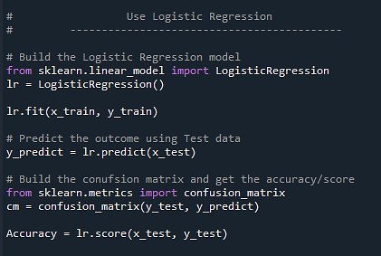
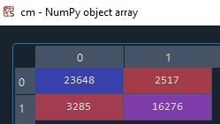
Evaluation of Logistic Regression Model
Lets look at the code, Confusion Matrix & Accuracy.
We will check the accuracy & Confusion Matrix under Logistic Regression with respect to various Feature selection & Dimensionality Reduction techniques also
Accuracy we got in this model training & testing is 87.31%

Slide 22
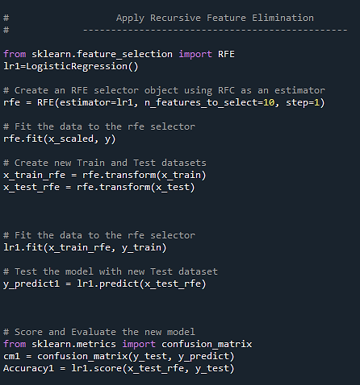
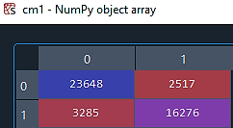
Logistic Regression with Recursive Feature Elimination (RFE)
Lets look at the code, Accuracy & Confusion Matrix
The accuracy with RFE with parameter=10, we have 86.88%
When we increase parameter we go close to accuracy we got in default LR model.
At no point the accuracy better than default LR accuracy.
What I understood through this evaluation is RFE is inversely proportional to LR accuracy.

Slide 23
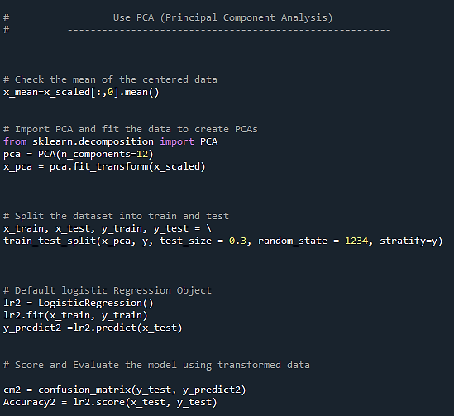
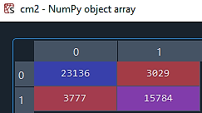
LR with Principal Component Analysis
The accuracy here is 85.11% with parameter 12.
I observed the same trend here, accuracy increases as we increase the parameter.
The objective of PCA is to reduce input features & have the best feature in model training.
Since all the features have strong influence on the target variable PCA doesn't help us much here

Slide 24
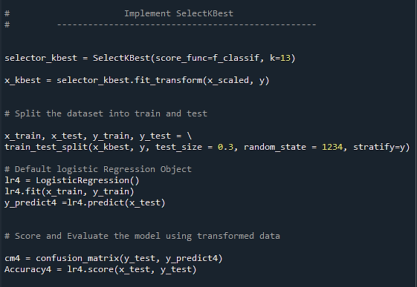
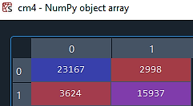
LR with Select kBest
This method help us select the best features to avoid overfitting to model
Accuracy with kBest is 85.52% when the parameter passed is 13.
Same trend here parameter increases accuracy increases but at no point exceeds the default LR accuracy.
kBest also doesn't have any significant affect on the LR model

Slide 25
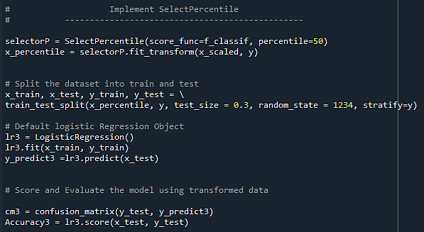
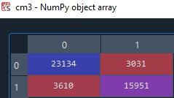
LR with Select percentile
Accuracy with select percentile is 85.48% when the parameter is 50.
Same trend here, parameter increases accuracy increases but never exceeds default LR accuracy.
Hence the objective of using this method doesn't fulfil.

Slide 26
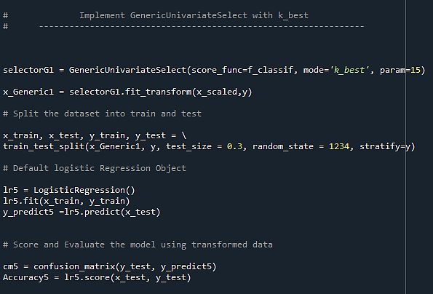
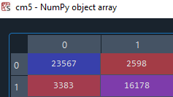
LR with Generic Univariate (kBest)
Accuracy with GUV-kBest is 86.92% when the parameter is 15.
Same trend here, parameter increases accuracy increases but never exceeds default LR accuracy.
Hence the objective of using this method doesn't fulfil.

Slide 27
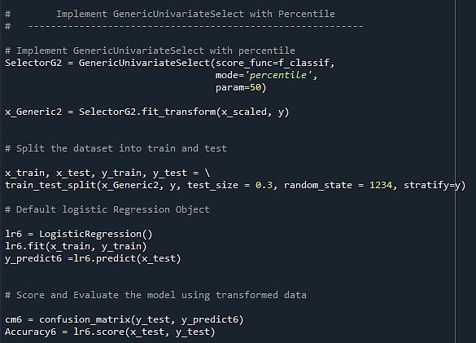
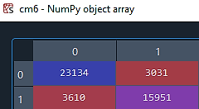
LR with Generic Univariate (percentile)
Accuracy with GUV-percentile is 85.48% when the parameter is 50.
Same trend here, parameter increases accuracy increases but never exceeds default LR accuracy.
Hence the objective of using this method doesn't fulfil.
Hence the default LR model is performing better till now with respect to feature selection techniques.

Slide 28
Decision Tree Classifier (DTC)

Slide 29
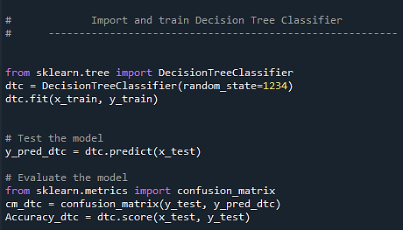
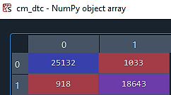
Evaluation of DTC
Lets look at the code, Confusion Matrix & Accuracy.
We will check the accuracy & Confusion Matrix under DTC with respect to various Feature selection & Dimensionality Reduction techniques also
Accuracy we got in this model training & testing is 95.73%
Decision Tree Classifier model is performing better than LR model.

Slide 30
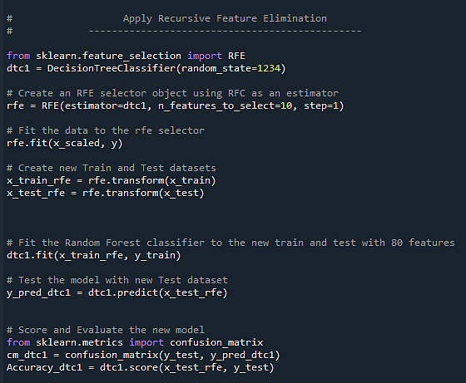
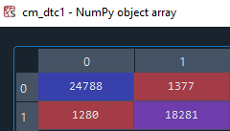
DTC with Recursive Feature Elimination
Accuracy with RFE is 94.20% when the parameter is 10.
Same trend here, parameter increases accuracy increases but never exceeds default DTC accuracy.
Hence the objective of using this method doesn't fulfil.

Slide 31
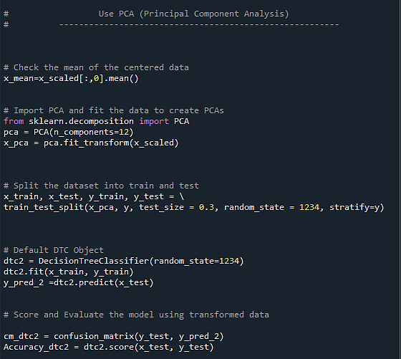
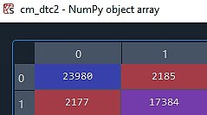
DTC with Principal Components Analysis
Accuracy with pca is 90.46% when the parameter is 12.
Same trend here, parameter increases accuracy increases but never exceeds default DTC accuracy.
Hence the objective of using this method doesn't fulfil.

Slide 32
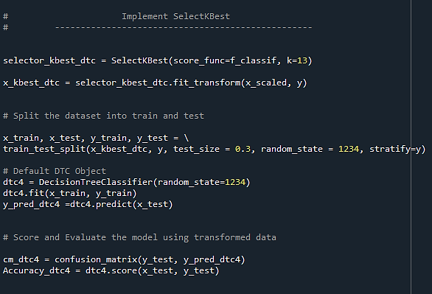
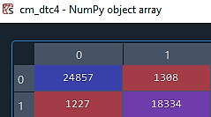
DTC with Select kBest
Accuracy with select-kBest is 94.46% when the parameter is 13.
Same trend here, parameter increases accuracy increases but never exceeds default DTC accuracy.
Hence the objective of using this method doesn't fulfil.

Slide 33
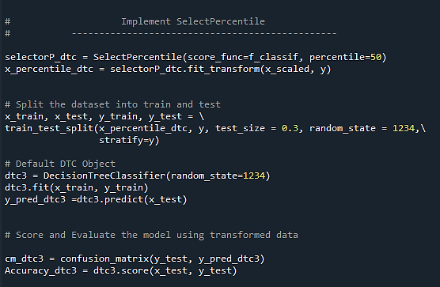
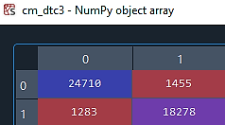
DTC with Select percentile
Accuracy with select percentile is 94.01% when the parameter is 50.
Same trend here, parameter increases accuracy increases but never exceeds default DTC accuracy.
Hence the objective of using this method doesn't fulfil.

Slide 34
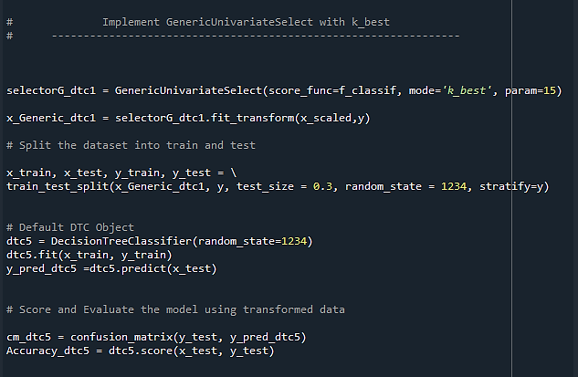
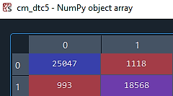
DTC with Generic Univariate-kBest
Accuracy with GUV-kBest is 95.38% when the parameter is 15.
Same trend here, parameter increases accuracy increases but never exceeds default DTC accuracy.
Hence the objective of using this method doesn't fulfil.

Slide 35
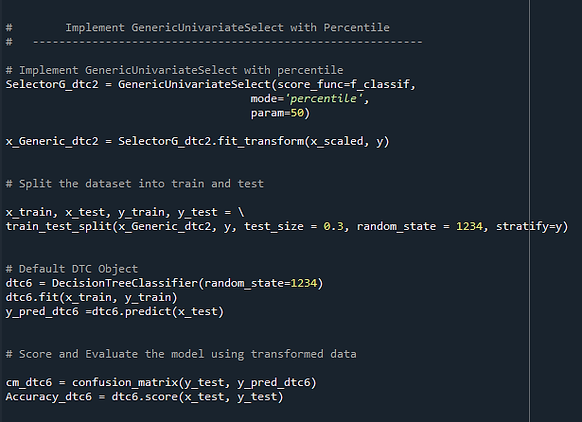
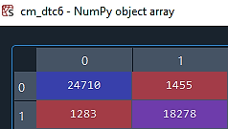
DTC with Generic Univariate-percentile
Accuracy with GUV-percentile is 94.01% when the parameter is 50.
Same trend here, parameter increases accuracy increases but never exceeds default DTC accuracy.
Hence the objective of using this method doesn't fulfil.
Default DTC have performed better than LR model.

Slide 36
Support Vector Machine
(SVM)

Slide 37
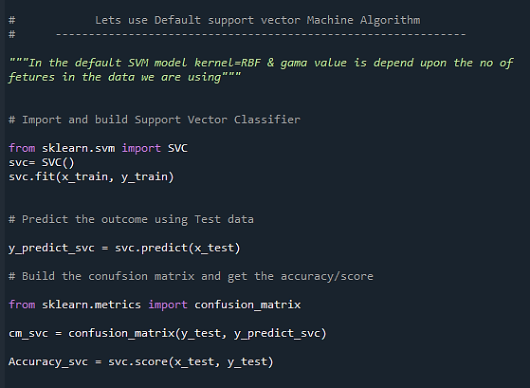
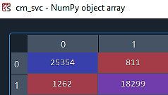
Evaluation of SVM
Lets look at the code, Confusion Matrix & Accuracy.
Accuracy we got with default SVM model training & testing is 95.47%
Same trend in SVM feature selection techniques also, as we increase parameter accuracy increases but never exceeds default SVM model accuracy.
Hence 95.47% is the best this model performs, which is slightly lower than DTC model.

Slide 38
Random Forest Classifier
(RFC)

Slide 39
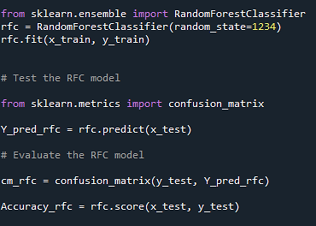
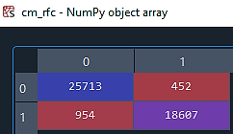
Evaluation of RFC
Lets look at the code, Confusion Matrix & Accuracy.
We will check the accuracy & Confusion Matrix under RFC with respect to various Feature selection & Dimensionality Reduction techniques also
Accuracy we got in this model training & testing is 96.93%, which is the best till now.
Random Forest Classifier model is performing better than LR, DTC, SVM model.
Lets apply the various feature selection/reduction techniques to cross verify if we get any better performance than default model.

Slide 40
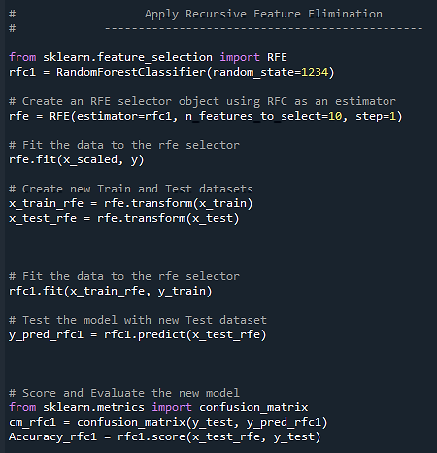
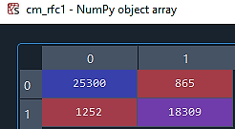
RFC with Recursive Feature Elimination
Accuracy with RFE is 95.37% when the parameter is 10.
Same trend here, parameter increases accuracy increases but never exceeds default RFC accuracy.
Hence the objective of using this method doesn't fulfil.

Slide 41
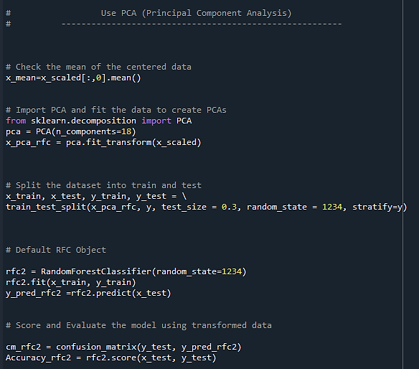
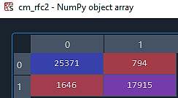
RFC with Principal Component Analysis (pca)
Accuracy with PCA is 94.66% when the parameter is 18.
Same trend here, parameter increases accuracy increases but never exceeds default RFC accuracy.
Hence the objective of using this method doesn't fulfil.

Slide 42
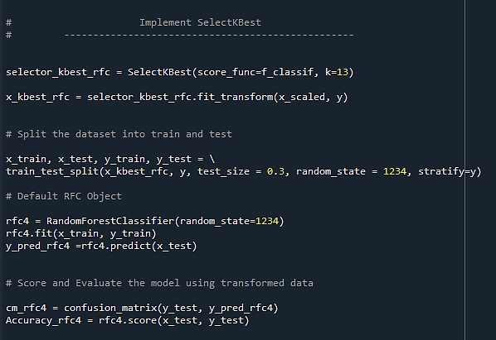
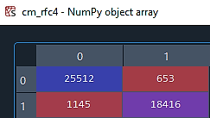
RFC with Select kBest
Accuracy with select kBest is 96.07% when the parameter is 13.
Same trend here, parameter increases accuracy increases but never exceeds default RFC accuracy.
Hence the objective of using this method doesn't fulfil.

Slide 43
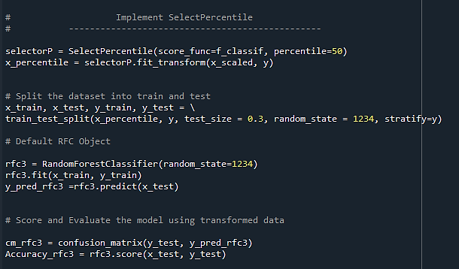

RFC with Select Percentile
Accuracy with select percentile is 95.52% when the parameter is 50.
Same trend here, parameter increases accuracy increases but never exceeds default RFC accuracy.
Hence the objective of using this method doesn't fulfil.

Slide 44


RFC with Generic Univariate-kBest
Accuracy with GUV-kBest is 94.66% when the parameter is 18.
Same trend here, parameter increases accuracy increases but never exceeds default RFC accuracy.
Hence the objective of using this method doesn't fulfil.

Slide 45


RFC with Generic Univariate-percentile
Accuracy with GUV-percentile is 94.66% when the parameter is 50.
Same trend here, parameter increases accuracy increases but never exceeds default RFC accuracy.
Hence the objective of using this method doesn't fulfil.

Slide 46
Result & Analysis
Result: After comparing various algorithms we tried on the data set, we found that default ‘Random Forest Classifier’ performs the best. Hence we go ahead & tarin the prediction model with ‘Random Forest Classifier’
About the Data:
F Test is highly significant with the data. All the input features have less than 0.05 p-value.
Default algorithms do best with the data, hence feature selection/reduction have almost 0 effect on the improvement of model performance.
Default models perform best as all the input features have strong influence on the target variable.
Feature selection & Dimensionality reduction methods are inversely proportional with the improvement of models accuracy.

Slide 47
Conclusion
‘Random Forest Classifier’ performs best with data set we used.
Hence we train our classification prediction model with RFC.

Slide 48
Acknowledgments
I would like to thank kaggel.com website for the data set resource.
Would also like to thank Mr. Jalal Khan sir for his guidance at every step I faced difficulties with.
Would also like thank BIA-Vashi for the opportunity to learn Data Science course & perform this project at their institute.

Slide 49
Contact Information
Name: Pravin S Varak
Mob: 9324452365
Email id: pravinvarak@ymail.com

